Slide 1

Business Analytics Capstone Consultancy Project.
Reducing Wait Time in Canada’s Healthcare :
The Power of Data Analytics.
Group
Dio Elikem Tsinyo Tay (Group Lead)
Sulaimon Ayotunde Olayode
Omowunmi Arinola Bamgbelu
Ozoemena Nwamadi
Michael Delos Santos
Notes:
In this presentation, we want to leverage the power of data analytics to understand the Wait time crisis for health services in Canada and proffer solutions that can help solve it.

Slide 2
Agenda
Industry Overview
Canada Amongst its Peers
The Wait Time Crisis
Research Questions
Analysis/Finding
Recommendations
Industry Overview
Canada Healthcare amongst its peers
The Wait Time Crisis
Our Research Questions
Recommendations
Our Analysis & Findings

Slide 3











Agenda
Industry Overview
Canada Amongst its Peers
The Wait Time Crisis
Research Questions
Analysis/Finding
Recommendations
Canada’s Healthcare is largely Public Funded: Universal Health Coverage and extended Health Benefits for Canadian Residents per Canada’s Health Act (1984)
Canada Health Act 1984
Public Admin.
Comprehensive
Universal
Accessible
Portable
1,300 Hospitals
Per Capita 8.5K
Primary Health Care
Providers
Secondary Health Care
Providers
Public
Private
Supplementary Health Care Providers
Tax Funded, Single Payer
Transfer Payments => Prov I Ter
Gov: Regulate Fund I Prov: License Deliver
Ferguson, Sarah Lord. “Supply and Demand in the Canadian Healthcare System”. Sage Publication, 2022.
Notes:
Publicly funded system that provides universal coverage for basic medical services on a need basis.
Covers health services that are medically necessary, including disease prevention, diagnosis, treatment of injury, illness or disability.
Funded through tax revenues collected by the Federal and Provincial governments. Provinces may also require their residents pay a premium to supplement finance received from Federal government (i.e., $0 to $900, if >$20k)
Established based on the principles of:
Public Administration
Comprehensiveness
Universality
Accessibility
Portability.
The fed­eral government is mainly concerned with providing funding for health services.
Provincial and ter­ritorial governments control the delivery, regulation, and licensing of health care.
Primary Healthcare
Comprises of nurses, nurse practitioners, physicians, family doctors, dietitians, physiotherapists and social workers.
First point of contact for primary health care services.
Ensures continuity of care by coordinating transfer of patient for specialized service.
Secondary Healthcare Providers
Provides specialized services not covered under the primary health care (e.g., home care, long-term care, chronic care, palliative care)
Provides service through community hospital or long-term care facilities funded through annual or global expenditure budget.
Service cost borne by provincial/territorial govt, except room and board.
Supplementary Health Care Providers
Provides service to senior citizens, children and low-income residents.
Services funded out-of-pocket or through extended health insurance funded by employers (i.e., not publicly funded).
Providers include dentist, optometrist and physiotherapist
Other service provided include prescription drugs outside hospital, medical equipment and appliances.

Slide 4
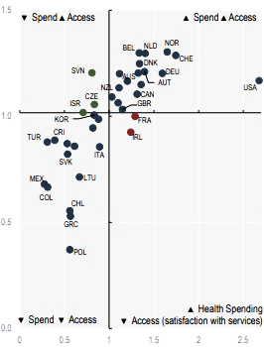
Ranks amongst the best globally based on % GDP & Satisfaction with Access
Agenda
Industry Overview
Canada Amongst its Peers
The Wait Time Crisis
Research Questions
Analysis/Finding
Recommendations
7th on Healthcare Budget as % GDP
Amongst the best on Satisfaction with Healthcare: Spend vs Access
7th
OECD Health Statistics 2021
Notes:
And is one of the best amongst its peers

Slide 5
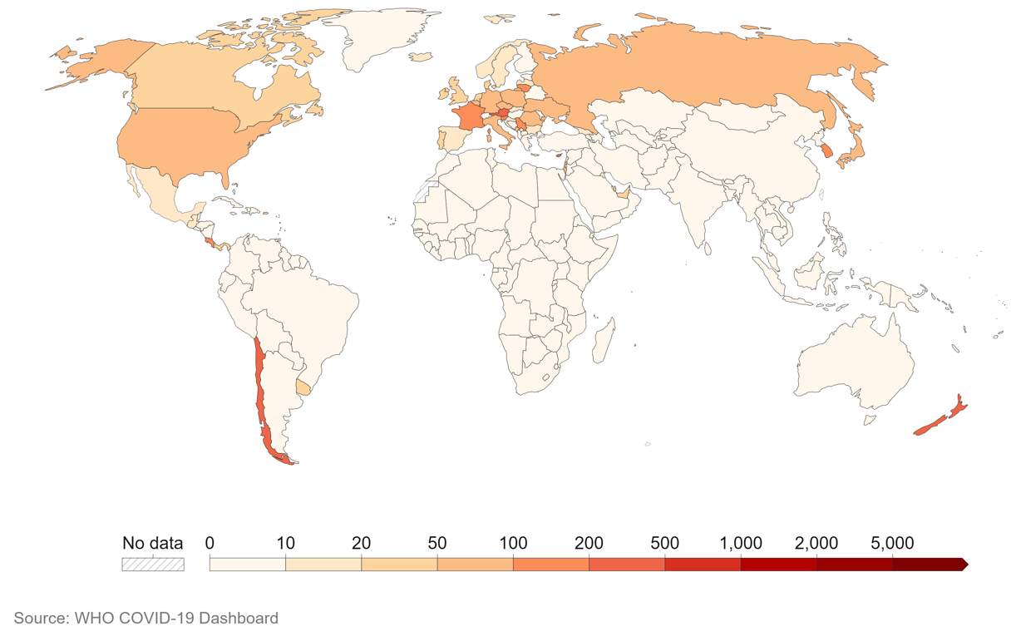
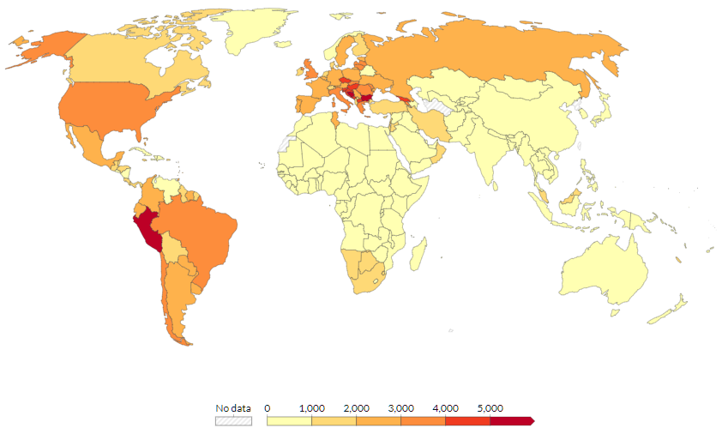
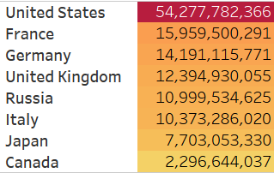
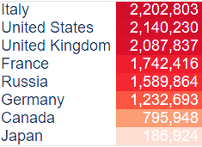
Covid 19 Pandemic Response: Canada is least impacted in morbidity and 2nd least in Mortality among G7 Nations
Agenda
Industry Overview
Canada Amongst its Peers
The Wait Time Crisis
Research Questions
Analysis/Finding
Recommendations
Morbidity; No of Covid 19 cases
Mortality : No. of Deaths
Canada
Canada
US
US
Sources:
Canada Public Health Agency
WHO Covid Data
Our World in Data
Notes:
This great standing is further evidenced by its performance amongst its peers during the Covid-19 pandemic

Slide 6

Agenda
Industry Overview
Canada Amongst its Peers
The Wait Time Crisis
Research Questions
Analysis/Finding
Recommendations
Agony of Long Wait times for healthcare services in recent Years
Picture Credit: Fraser Institute Report, Waiting Your Turn 2022
Notes:
Despite Canada’s great standing amongst its peers, The agony of Long Wait time for health services in recent years continues to dominate the angsts of Canadian residents

Slide 7

Agenda
Industry Overview
Canada Amongst its Peers
The Wait Time Crisis
Research Questions
Analysis/Finding
Recommendations
Word Cloud based using Python and text corpus from Fraser Report’s Waiting Your Turn 2022
Notes:
And a lot of research has also brought the angst Wait time to the fore….

Slide 8
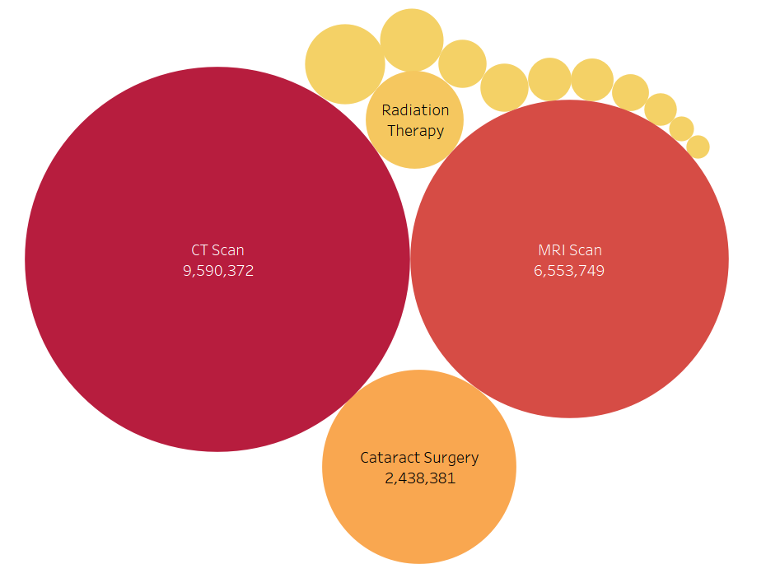
Out of 14 Medical Services impacted by Wait Time from 2008-2022, Diagnostic Imaging ( CT scan and MRI) accounts for over 70%
Agenda
Industry Overview
Canada Amongst its Peers
The Wait Time Crisis
Research Questions
Analysis/Finding
Recommendations
Data Source: Canadian Institute for Health Information: Wait time Priority Procedures 2008-2002
Notes:
Thanks Ozzy, Now let us diagnose what is creating this agony………: Out of 14 Medical Services impacted by Wait Time from 2008-2022, Diagnostic Imaging ( CT scan and MRI) accounts for over 70%

Slide 9
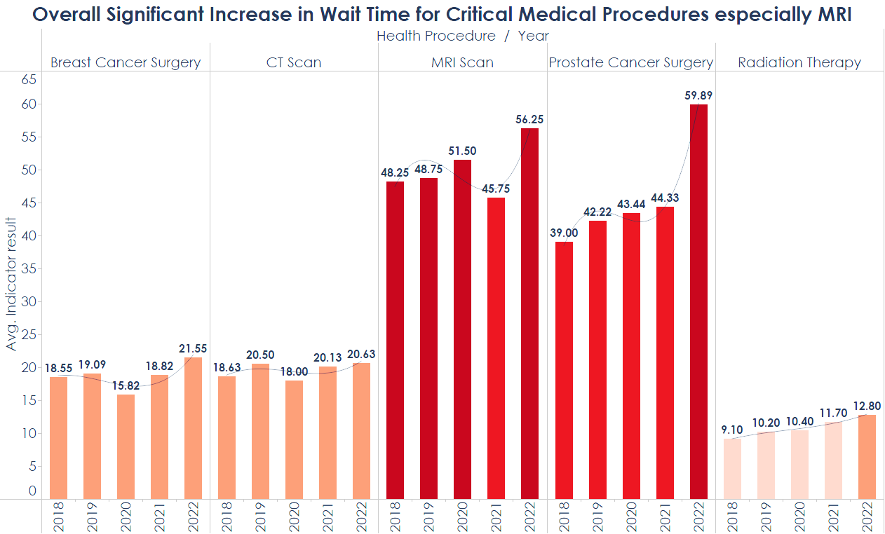



MRI records the Worst Wait Time in the most critical healthcare service Category : Diagnostic Imaging !
Agenda
Industry Overview
Canada Amongst its Peers
The Wait Time Crisis
Research Questions
Analysis/Finding
Recommendations
Scheduled cases (Non-Urgent): 30 Days
Urgent Cases: 7 Days Max
Emergency Cases: Max 24h
Source: 2005 Benchmark Days by Canadian Radiologist Association (CAR)
Dat Source: Canadian Institute for Health Information: Wait time Priority Procedures, 2023
Notes:
Priority 1 -Emergency Cases : Immediate Danger to Life, Limb or Organ: Immediate to 24h
Priority 2: Urgent Cases: Situation that is unstable and has the potential to deteriorate quickly and result in an emergency admission: Within 7 days
Priority 3: Scheduled Cases: Situation Involving Minimal pain dysfunction or disability (routine or elective): 30 days

Slide 10
Agenda
Industry Overview
Canada Amongst its Peers
The Wait Time Crisis
Research Questions
Analysis/Finding
Recommendations
What are the challenges of Physicians & Nurse Practitioners
How can data analytics help manage and improve current wait time
Notes:
We therefore ask following research questions ……..
What are the challenges of Physicians & Nurse Practitioners during & post Covid-19
This research question examines how the pandemic has affected the demand and utilization of both physicians and nurse practitioners in various healthcare settings, such as hospitals, primary care clinics, long-term care facilities, and telehealth services.
It investigates in-patient load, the distribution of workload between professions, and the adaptability of each profession to different care delivery models.
What are the factors influencing the job satisfaction, well-being, and retention of physicians and nurse practitioners in Canada's healthcare workforce
How has the adoption of telemedicine and virtual care impacted the practice patterns and patient outcomes for physicians and nurse practitioners in Canada during the COVID-19 pandemic?
This research question examines the extent to which physicians and nurse practitioners have embraced telemedicine and virtual care as a response to the pandemic. It investigates how the use of these technologies has influenced their practice patterns, patient interactions, healthcare outcomes, and the accessibility of care across different populations and regions.
How can big data in healthcare enable a more responsive and resilient healthcare post covid-19?
What are the ethical and privacy impediments to a patient-centered healthcare database?
How can data analytics help anticipate and manage future pandemics or crises better among Healthcare providers?
What are the policy implications for the training, education, and future workforce planning of physicians and nurse practitioners in Canada based on data collected

Slide 11
Agenda
Industry Overview
Canada Amongst its Peers
The Wait Time Crisis
Research Questions
Analysis/Finding
Recommendations
Canada ranks 17th out of 25 countries and lags behind OECD’s No. of Physician Per 1,000 population
17th on ratio of Practicing doctors per 1 000 population
Practicing Nurses per 1 000 population above OECD average
Overload
Overtime
Burnout
Fatigue
Unpaid overtime
Adequate but limited usage or involvement of NPs due to power dynamics
OECD Health Statistics 2021
Notes:
What are the challenges of Physicians & Nurse Practitioners during & post Covid-19
This research question examines how the pandemic has affected the demand and utilization of both physicians and nurse practitioners in various healthcare settings, such as hospitals, primary care clinics, long-term care facilities, and telehealth services.
It investigates in-patient load, the distribution of workload between professions, and the adaptability of each profession to different care delivery models.
What are the factors influencing the job satisfaction, well-being, and retention of physicians and nurse practitioners in Canada's healthcare workforce
How can big data in healthcare enable a more responsive and resilient healthcare post covid-19?
What are the ethical and privacy impediments to a patient-centered healthcare database?
How can data analytics help anticipate and manage future pandemics or crises better among Healthcare providers?
What are the policy implications for the training, education, and future workforce planning of physicians and nurse practitioners in Canada based on data collected

Slide 12
Agenda
Industry Overview
Canada Amongst its Peers
The Wait Time Crisis
Research Questions
Analysis/Finding
Recommendations
Canada ranks 17th out of 19 countries on No. of MRI / 1 million population: instrumentation inadequacy
OECD Health Statistics 2021

Slide 13
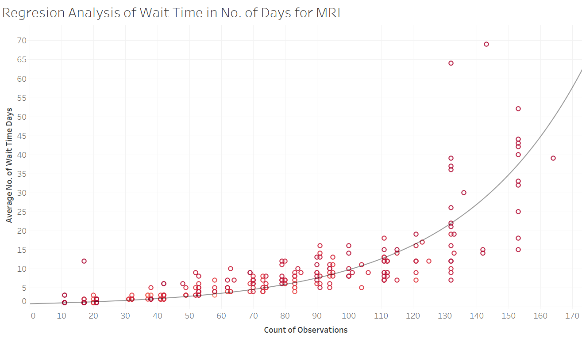
Agenda
Industry Overview
Canada Amongst its Peers
The Wait Time Crisis
Research Questions
Analysis / Finding
Recommendations
Predicting outlook of the Crisis : Wait time to worsen exponentially considering build-up in wait time before covid-19 and its sequels afterwards!
Wait Time=0.768* ^{exp(0.0254*Cases)}
R Squared: 0.91
P value : 0.0001
Based on Wait Time & Number of Cases Data on 14 Procedures from CIHI from 2008-2002
Notes:
That was a good diagnosis of the illness of Wait Time which is afflicting Canada’s Healthcare, Dr Solomon!
Now , as Data Analysts, we sought to use the power of Data Analytics, specifically Predictive Analytics to model the outlook of the crisis: We collected and examined secondary data samples CIHI data samples from CIHI on wait times for from 2008-2022 for MRI across Canada. Using Excel to wrangle the data and deployed a Linear Regresssion in Tableau to anticipate or predict how the better or worse Wait Time is likely to be going forward. Based the data analysis and outlook of our regression model we postulate that Wait Time is going to worsen exponentially going forward. …..Urgent action is required

Slide 14
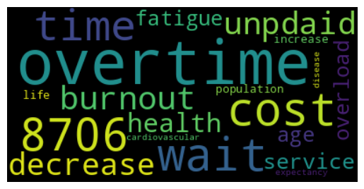
Agenda
Industry Overview
Canada Amongst its Peers
The Wait Time Crisis
Research Questions
Analysis/Finding
Recommendations
The Economic Cost of Wait Time estimated at $14.8 Billion (2007) and $8,706 per capita!!
The cumulative total lost economic output that represents the cost of waiting longer than medically recommended for treatment for total joint replacement surgery, cataract surgery was $14.8 billion coronary artery bypass graft surgery, and MRI scans in 2007 was an estimated
1. Sommerville and Stokes (2008)
2. Moir and Barua (2022)
Notes:
Moreso, economic models estimate the cost of wait of time to be over $8,000 to an individual Canadian residents, not to mention further complications and irreversible damage ( and what we prefer not to mention) and to the Canadian economy it is estimated to erode as much as $14.8 billion.

Slide 15
Agenda
Industry Overview
Canada Amongst its Peers
The Wait Time Crisis
Research Questions
Analysis / Finding
Recommendations
“One thing that for sure the pandemic has taught us is how central the health of our society, our health care system, is to a well-functioning society. So, we do need to build a more resilient health care system that can sustain this. We need to do the work to ensure that we’ve got that resilient health care system so it’s there when people need it.”
CIHI :Overview: Impacts of COVID-19 on health care providers | CIHI
Notes:
With the foregoing, we prescribe the following short, medium and long term recommendations

Slide 16










Agenda
Industry Overview
Analysis
Literature Review
Analysis & Interpretation
Recommendations
Fed Gov. Engage Physicians
Maximize Nurse Practitioners
Engage Medical Association for Road Map on Wait times
Maximize deployment, availability and usage
Short Term
Develop Wait Time Targets and build achievement incentives into “Fee for Service”
Engage Data Analysts in FMoH
Deploy Data Analyst in Healthcare Administration & Standardize data Reporting
Set & Incentivize Wait Time Targets
Invest in Point of Care Diagnostics technologies for Physicians and Nurse Practitioners.
Increase Instrument(MRI, CT…) Installed Base
Understudy OECD
Models
Medium Term
Invest in Diagnostics
(MRI)
& Point of Care
Understudy Healthcare Model of other OECDs countries and leverage best practice
Improve Physicians Ratio /1,000 pop. to 7th in OECD over 5-10 years
Use Data Analytics to predict Licensing and hiring levels of Physicians and Nurse Practitioners
Attract & Facilitate Foreign talent
Reduce Red Tape
Leverage Big Data Technology
Long Term
Invest in Healthcare National Database leveraging Big Data technologies such Data Lakes and the Cloud (using Python, SQL…)

Slide 17
Agenda
Industry Overview
Canada Amongst its Peers
The Wait Time Crisis
Research Questions
Analysis / Finding
Recommendations
Fed Gov. Engage Physicians
Maximize Nurse Practitioners
Engage Medical Association for Road Map on Wait times
Maximize deployment, availability and usage
Short Term
Develop Wait Time Targets and build achievement incentives into “Fee for Service”
Engage Data Analysts in FMoH
Deploy Data Analyst in Healthcare Administration & Standardize data Reporting
Set & Incentivize Wait Time Targets
Medium Term
Invest in Point of Care Diagnostics technologies for Physicians and Nurse Practitioners.
Increase Instrument(MRI, CT…) Installed Base
Understudy OECD
Models
Invest in Diagnostics
(MRI)
& Point of Care
Understudy Healthcare Model of other OECDs countries and leverage best practice
Improve Physicians Ratio /1,000 pop. to 7th in OECD over 5-10 years
Use Data Analytics to predict Licensing and hiring levels of Physicians and Nurse Practitioners
Attract & Facilitate Foreign talent
Reduce Red Tape
Leverage Big Data Technology
Long Term
Invest in Healthcare National Database leveraging Big Data technologies such Data Lakes and the Cloud (using Python, SQL…)

Slide 18
Agenda
Industry Overview
Analysis
Literature Review
Analysis & Interpretation
Recommendations
Fed Gov. Engage Physicians
Nurse Practitioners
Engage Medical Association for Road Map on Wait times
Maximize deployment, availability and usage
Short Term
Wait Time Targets
Engage Data Analysts
Develop Wait Time Targets and build achievement incentives into “Fee for Service”
Deploy Data Analyst in Healthcare Administration and Standardize Reporting
Diagnostics & Point of Care
Medium Term
Invest in Point of Care Diagnostics technologies for Physicians and Nurse Practitioners.
Increase Instrument(MRI, CT…) Installed Base
Under Study in OECD
Understudy Healthcare Model of other OECDs countries and leverage best practice
Long Term
Red Tape
Leverage Data Technology (Big Data)
Improve Physicians Ratio /1,000 pop. to 7th in OECD over 5-10 years
Use Data Analytics to predict Licensing and hiring levels of Physicians and Nurse Practitioners and Attract & Facilitate Foreign talent
Invest in Healthcare National Database leveraging Big Data technologies such Data Lakes and the Cloud (using Python, SQL…)

Slide 19
Dhalla, I.A., & Tepper, J. (2018). Improving the quality of health care in Canada, Canadian Medical Association Journal, 190(39), 1162-1167. https://www.ncbi.nlm.nih.gov/pmc/articles/PMC6167219/
Canada’s health care crises: What we need now (2022). Canadian Medical Association, https://www.cma.ca/news/canadas-health-care-crisis-what-we-need-now
Health Human Resources: Balancing Supply and Demand (2004). Government of Canada, https://www.canada.ca/en/health-canada/services/science-research/reports-publications/health-policy-research/health-human-resources-balancing-supply-demand.html
Esmail, N., (2023, May 23). Canadian Medicare Deserves Its Criticism. Fraser Institute. https://www.fraserinstitute.org/article/canadian-medicare-deserves-its-criticism
Ferguson, S., (2022). Supply and demand in the Canadian healthcare system. In Sage Business Cases. SAGE Publications, Ltd., https://doi.org/10.4135/9781529773316
WHO Regional Office for Europe. (2020). Canada health system review 2020. WHO European Observatory on Health Systems and Policies. Retrieved May 23, 2023, from https://eurohealthobservatory.who.int/publications/i/canada-health-system-review-2020
PPT - Overview of the Canadian Health Care System PowerPoint Presentation - ID:4282703 (slideserve.com)
Canadian Institute for Health Information. Wait Times for Priority Procedures in Canada — Data Tables. Ottawa, ON: CIHI; 2023.
OECD Health Statistics 2023 – OECD
<iframe src="https://data.oecd.org/chart/79qq" width="860" height="645" style="border: 0" mozallowfullscreen="true" webkitallowfullscreen="true" allowfullscreen="true"><a href="https://data.oecd.org/chart/79qq" target="_blank">OECD Chart: Health spending, Total / Government/compulsory / Voluntary, US dollars/capita, Annual, 2022</a></iframe>

